Slide 1

Working With Links

Slide 2
Introduction
Links can be accessed using an exact or partial match of their link text.
Accessing Links
Exact Match
Partial Match
Case-sensitivity
All Links
Links Outside and Inside a Block
Accessing Image Links

Slide 3
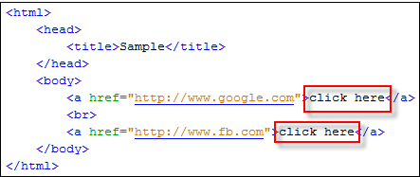
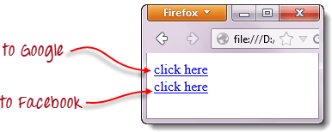
Exact Match
Accessing links using their exact link text is done through the By.linkText() method.
If there are two links that have the very same link text, this method will only access the first one. Consider the HTML code below:

Slide 4
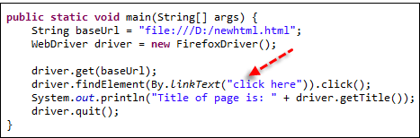
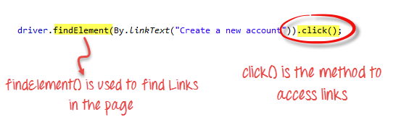
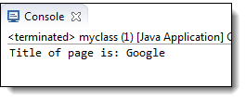
Accessing the first "click here" link code mention below:-
Here is how it works-
As a result, It will automatically taken to Google.

Slide 5
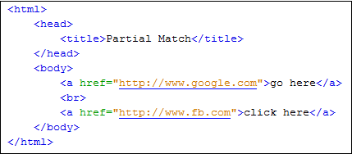
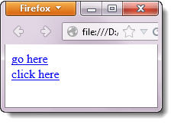
Partial Match
Accessing links using a portion of their link text is done using the By.partialLinkText() method.
If you specify a partial link text that has multiple matches, only the first match will be accessed. Consider the HTML code below

Slide 6
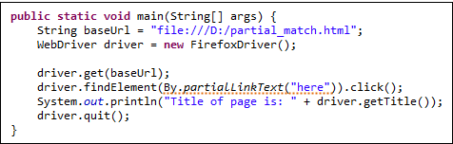
Accessing the first "here" link code mention below:-
Access the links other than the first one different locators Like By.xpath(), By.cssSelector() or By.tagName() are used.
Most commonly used is By.xpath().

Slide 7
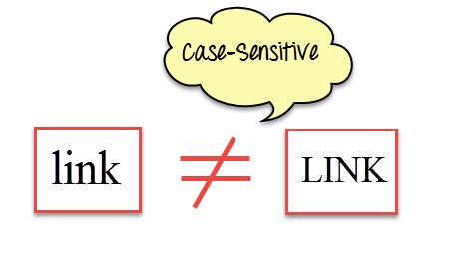
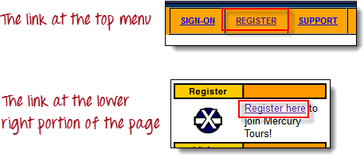
Case-sensitivity
The parameters for By.linkText() and By.partialLinkText() are both case-sensitive. For example:-Two links that contain the text "egis" - one is the "REGISTER" link found at the top menu, and the other is the "Register here" link found at the lower right portion of the page.

Slide 8
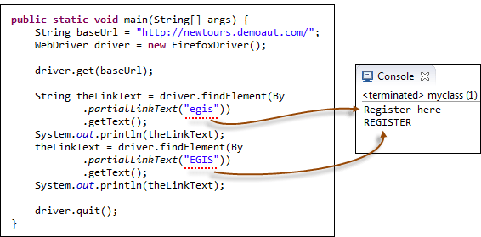
Though both links contain the character sequence "egis," one is the "By.partialLinkText()" method will access these two links separately depending on the capitalization of the characters. See the code below:-

Slide 9
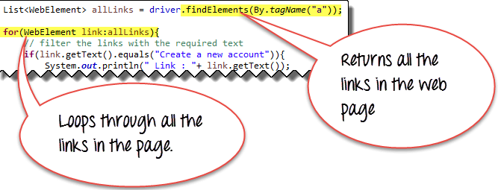
All Links
Testing of all the links present within the page are working by using a combination of the Java for-eachloop, findElements() & By.tagName("a")method.
The findElements() method returns a list of Web Elements with tag a. Using a for-each loop, each element is accessed.

Slide 10
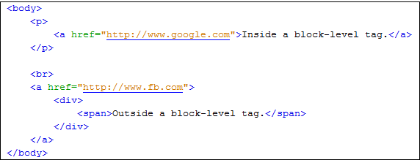
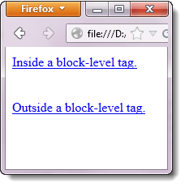
Links Outside and Inside a Block
The latest HTML5 standard allows the <a> tags to be placed inside and outside of block-level tags like <div>, <p>, or <h3>.
The "By.linkText()" and "By.partialLinkText()" methods can access a link located outside and inside these block-level elements. Consider the HTML code below:-

Slide 11
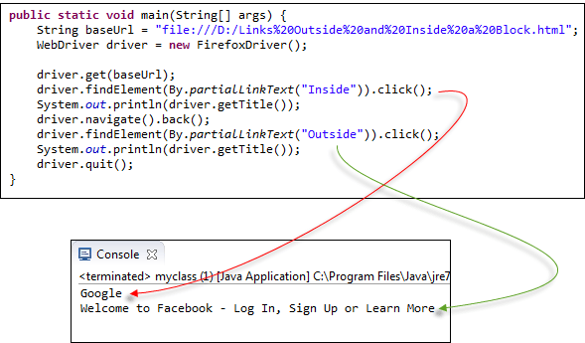
Accesses both of these links using By.partialLinkText() method code mention below:-

Slide 12
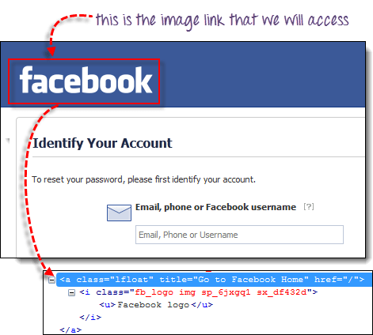
Accessing Image Links
Image links are the links in web pages represented by an image which when clicked navigates to a different window or page.
By.cssSelector or By.xpath methods can used for accessing a Image link.
In the example below, we will access the "Facebook" logo on the upper left portion of Facebook's Password Recovery page.
driver.findElement(By.cssSelector("a[title=\"Go to Facebook home\"]")).click();

Slide 13
Covered Till Now
Links are accessed using the click() method.
Apart from the locators available for any WebElement, Links also have link text based locators:
By.linkText() – locates the links based on the exact match of the link's text provided as a parameter.
By.partialLinkText() – locates links based on the partial text match of the link's text.
Both the above locators are case Sensitive.
If there are multiple matches, By.linkText() and By.partialLinkText() will only select the first match. In such cases where multiple links with the same link text are present, other locators based on xpath, CSS are used.
findElements() & By.tagName("a") method finds all the elements in the page matching the locator criteria.
Links can be accessed by the By.linkText() and By.partialLinkText() whether they are inside or outside block-level elements.
Accessing image links are done using By.cssSelector() and By.xpath() methods.

Slide 14
Thanks

